Slide 1

Coastal Management
an Insurance Industry Perspective
Andrew Saunders
Regulatory Affairs Manager
Insurance Council of New Zealand
21 September 2018

Slide 2
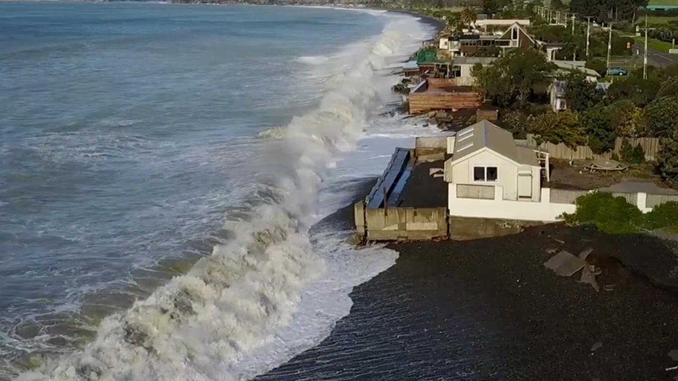
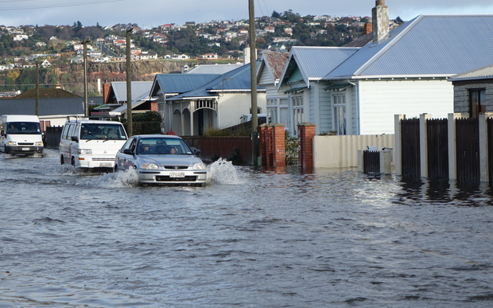
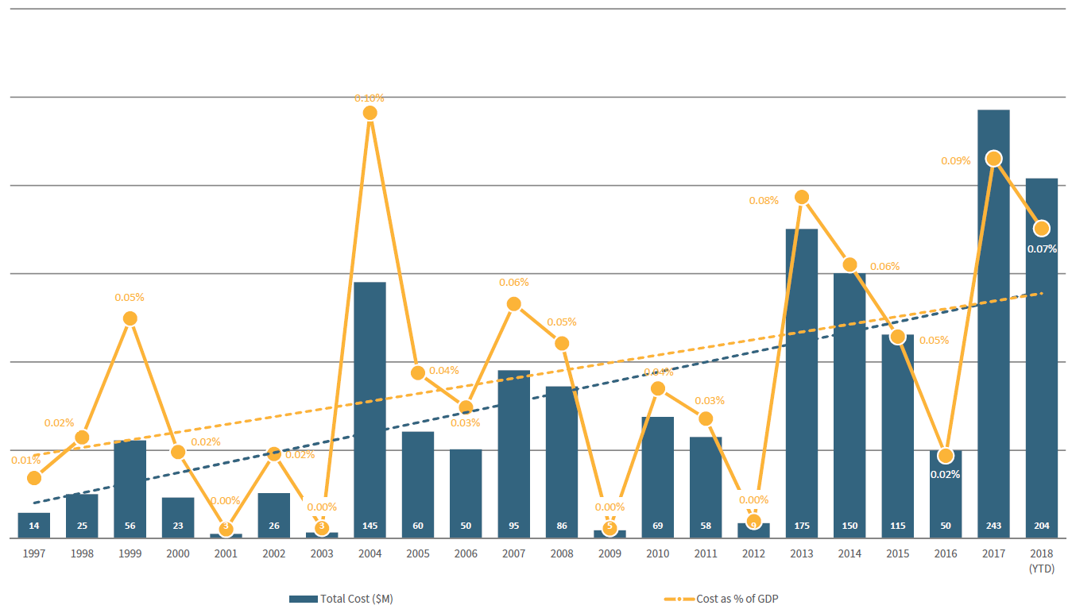
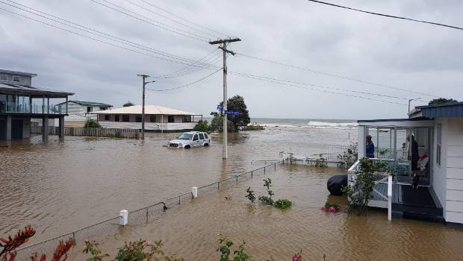
Recent New Zealand experience
Flood, storm surge and sea level rise
NZ generally well insured, so high % of property losses are insured
2017 was record year for weather related insured losses ($243m) and 2018 also high (~$220m thus far)
As a coastal nation NZ is vulnerable to sea-level rise:
Replacement value of buildings within 0.5m of the spring high tide mark is $3 billion and that of buildings within 1.5m is approximately $20 billion.
Around 9,000 homes within 0.5m and 44,000 homes within 1.5m.

Slide 3
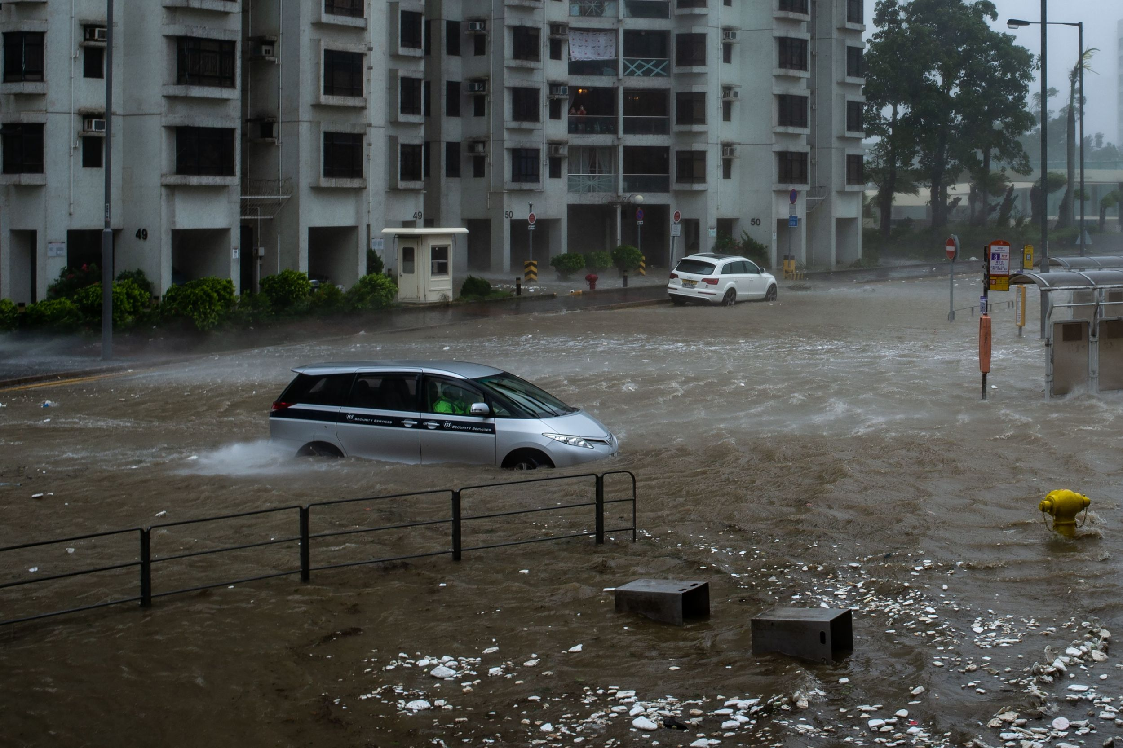
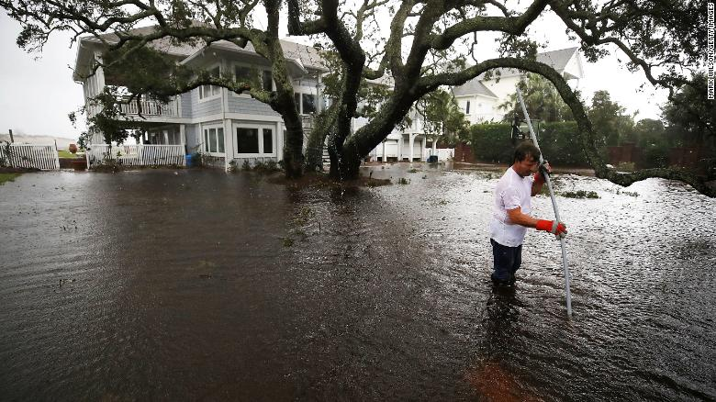
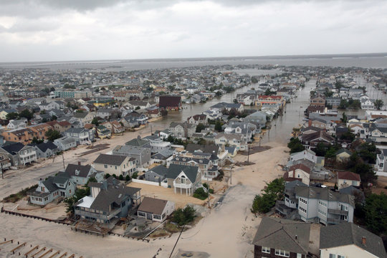
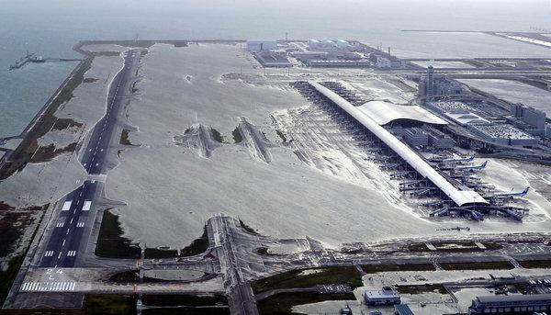
SPEAKER LOGO
Global as well as local
2018, Typhoon Mangkhut
2018, Hurricane Florence
2012, Hurricane Sandy
2018, Typhoon Jebi, Kansai Airport

Slide 4
Insurance – fundamentals
SPEAKER LOGO
Insurance simply transfers risk from the insured to the insurer, it does not reduce the risk.
Traditional insurance works well for potential events that are accidental and unlikely, by pooling risk and premiums so the many pay for the few who suffer losses.
Traditionally premiums based on claims made (i.e. backward looking), but changing with predictive models to be more forward looking.
Insurers also looking at greater risk-rating - technology, science and modelling enabling more granular assessment of risk.

Slide 5
Implications
SPEAKER LOGO
Unless coastal risk exposures (from climate change or otherwise) are managed, insurers will respond through premiums, increasing excesses, exclusions or refusal to go on risk.
Losses from sea-level rise are foreseeable and inevitable, and therefore un-insurable.
Property (residential and commercial) purchase and development is generally funded by banks who depend on insurance to underwrite the risk on the assets they loan for/against.
Insurance contract and premium signal only applies to the next 12 months – property owners and planners need to look beyond that to the long term risk-profile.

Slide 6
Coastal planning/management: take the long view
SPEAKER LOGO
Manage risk over longer term by considering:
where we build in future - don’t consent where adaptation can’t work
how we build e.g. requirements placed on developers
providing information on current and future risks
protecting existing infrastructure
upgrading existing infrastructure to 21st century needs e.g. storm-water drains
building new infrastructure where appropriate (e.g. sea-walls)
relocatable buildings/retreat where risk is too high/doesn’t make no sense to protect long term
improving warning systems and public education – so there is time to reduce the impact of storms etc
taking an ongoing and proactive approach to adaptation using tools such as adaptive pathways

